Slide 1
Employee Data Analysis using Excel
STUDENT NAME: RENUGA DEVI . B
REGISTER NO: 312215064
DEPARTMENT: COMMERCE
COLLEGE : SOKA IKEDA COLLEGE OF ARTS AND SCIENCE FOR WOMEN

Slide 2
PROJECT TITLE
Employee Performance Analysis using Excel

Slide 3


AGENDA
Problem Statement
Project Overview
End Users
Our Solution and Proposition
Dataset Description
Modelling Approach
Results and Discussion
Conclusion
3/21/2024 Annual Review

Slide 4

PROBLEM STATEMENT It is made for company Profitable growth and success and also Employee personal growth too ..

Slide 5

PROJECT OVERVIEW The primary purpose of an employee database is to store and organize employee related information for administrative , operational and analytical purposes.
.

Slide 6

WHO ARE THE END USERS? 1 . Company Management 2 . Employee

Slide 7

OUR SOLUTION AND ITS VALUE PROPOSITION 1 . Filtering – It removes the missing values 2 . Conditinal Formating - Blanks 3 . Pivot table – Summary of employee performance 4 . Formulas – IF 5 . Graphs – FINAL REPORT

Slide 8
Dataset Description Employee Dataset : Kaggle features :out of 26 / 9 features Employee ID: Unique identifier for each employee in the organization. First Name: The first name of the employee. Last Name: The last name of the employee. Start Date: The date when the employee started working for the organization. Exit Date: The date when the employee left or exited the organization (if applicable). Business Unit: The specific business unit or department to which the employee belongs. Employee Type: The type of employment the employee has (e.g., Full-time, Part-time, Contract). Pay Zone: The pay zone or salary band to which the employee's compensation falls. Employee Classification Type: The classification type of the employee (e.g., Exempt, Non-exempt). Termination Type: The type of termination if the employee has left the organization. Gender : Male and female

Slide 9

THE "WOW" IN OUR SOLUTION
Formula : IF (A8>5,”HIGH”,IF (A8<5,”MEDIUM”,”LOW”)
3/21/2024 Annual Review
9

Slide 10
MODELLING
Data set : kaggle , Employee dataset
Data Cleaning : Missing values , Irrelevant
Formula : performance calculation , low , med , high
Pivot table : summary , business unit , Gender , Employment type , Employee Id , performance
Chart : Report : slicer
10

Slide 11
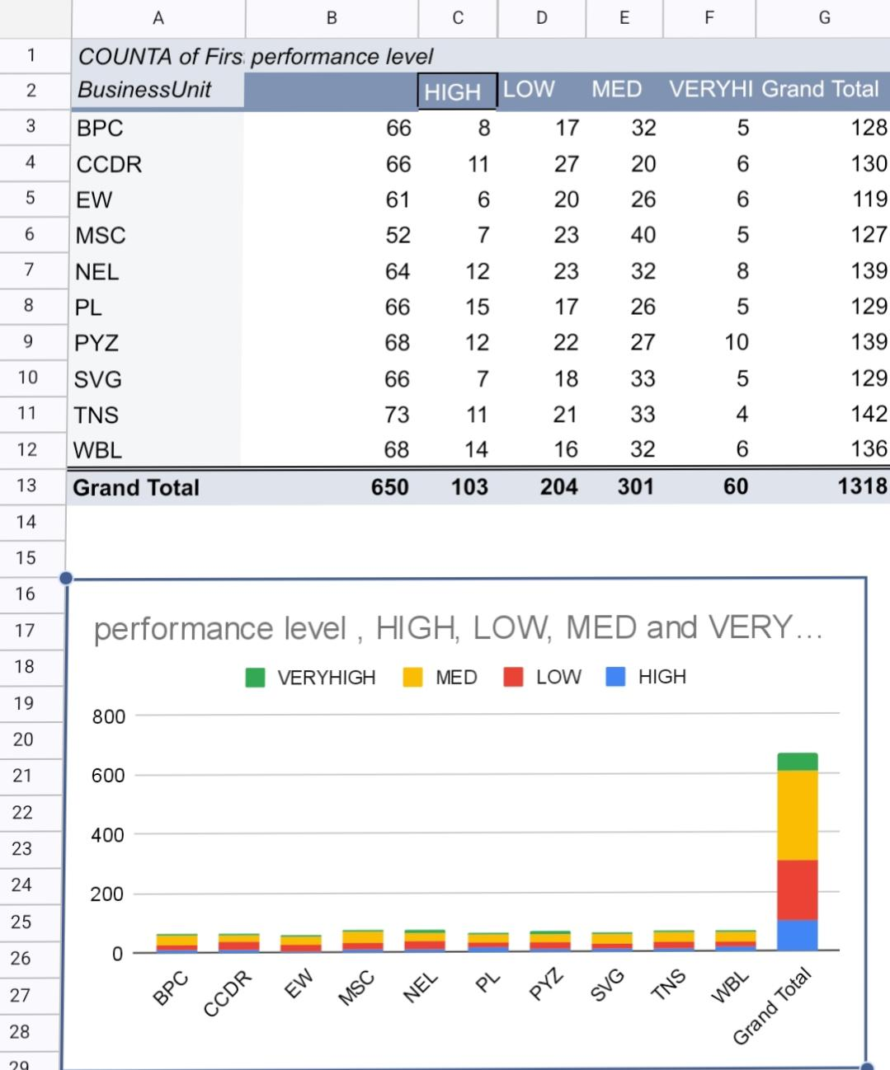
RESULTS
11

Slide 12
conclusion
Based on our analysis , we found significant trends in
Employee performance and turnover , highlighting the need for targeted training and improved retention strategies . Enhancing employee satisfaction and addressing key issues will be crucial for optimizing overall workforce effectiveness.

